Slide 1
Agilent Punchout How To
Request, Retrieve, and Purchase a Quote Through Punchout

Slide 2
Customer Quote Request and Retrieval
Go to your eProcurement Homepage
Select Agilent on your eProcurement Homepage

Slide 3
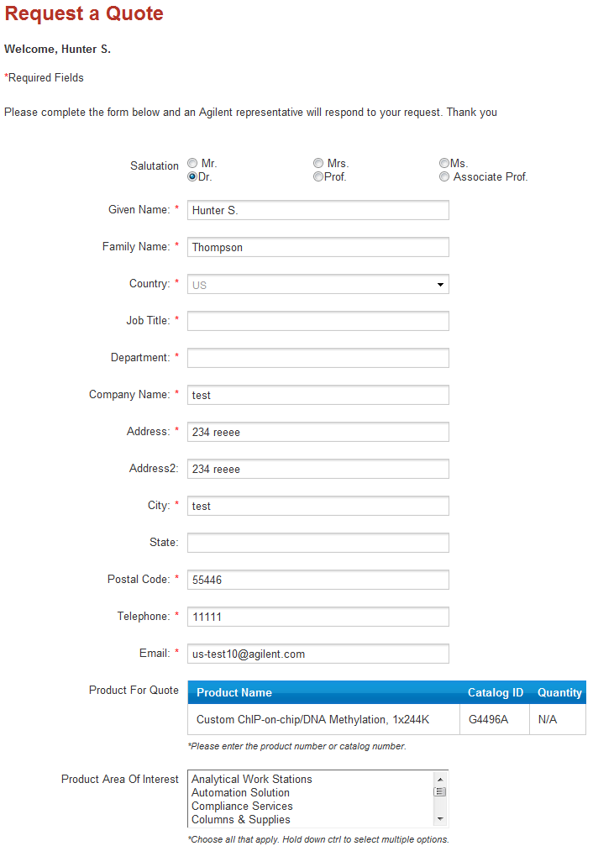
Request A Quote
Select a Product or basket of products
Then Press Request a Quote
Fill out basic contact information and products of interest

Slide 4
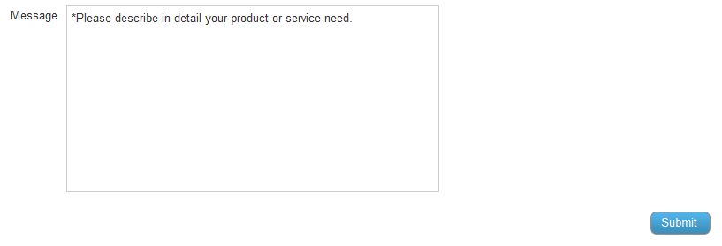
Request A Quote
When Complete Press Submit
Once submitted the request will go to your designated Account Manager to be created

Slide 5
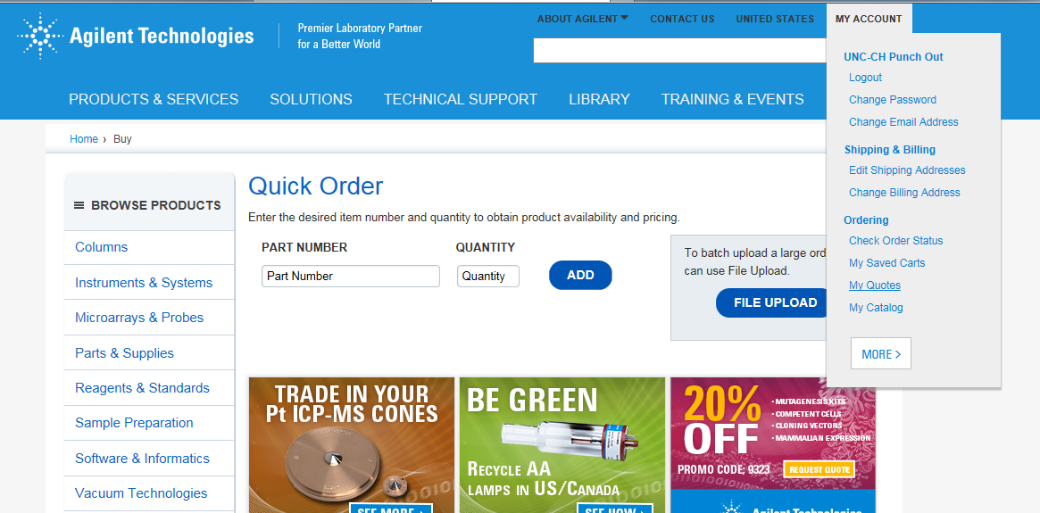
Customer Quote Retrieval
This is the Landing Page you will come to
Go to “My Account”
Then go to “My Quotes”

Slide 6
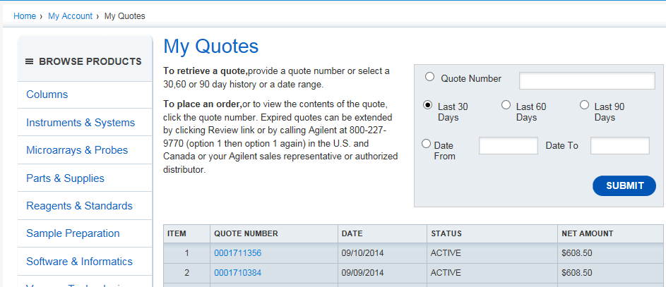
Customer Quote Retrieval
They can then search by Quote number
They will then select the Quote

Slide 7
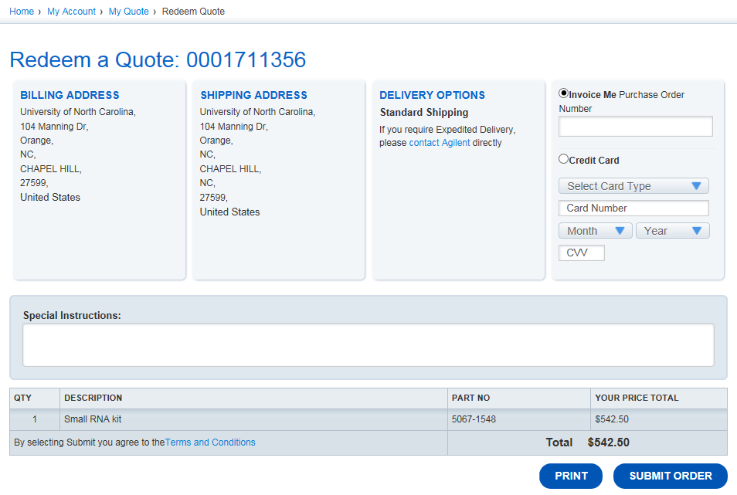
Customer Quote Retrieval
They will then transfer the cart to their system to complete the purchase

